Slide 1
Generative Timetable using Genetic Algorithm
Aanand Sunil Ingle & Gayatri Rameshwar Donatkar
Department of Computer Science
Sir Parashurambhau College, Pune

Slide 2
Project Members
Aanand Sunil Ingle (Backend Development)
Gayatri Rameshwar Donatkar (Frontend Development)

Slide 3
Project Topic
Generative Timetable using Genetic Algorithm

Slide 4
Technologies Used
Backend: Flask (Python)
Database: MySQL
Frontend: HTML, CSS, JavaScript
AI Algorithms: Genetic Algorithm
Other Libraries: NumPy, Pandas

Slide 5
Existing System
Manual timetable creation is time-consuming and error-prone, especially for large institutions.

Slide 6
Proposed System
An AI-powered web application that generates conflict-free timetables by considering constraints like faculty availability, classrooms, and schedules.

Slide 7
Requirements
Software:
  Python, Flask, MySQL, HTML, CSS, JavaScript
Hardware:
  System with at least 8GB RAM & multi-core processor

Slide 8
Project Modules
Input Constraints
AI Algorithm for Timetable Generation
User Interface & Customization
Timetable Storage & Retrieval

Slide 9
What We Learned from This Project
Application of AI in scheduling
Database design & optimization
Handling real-world constraints in software

Slide 10
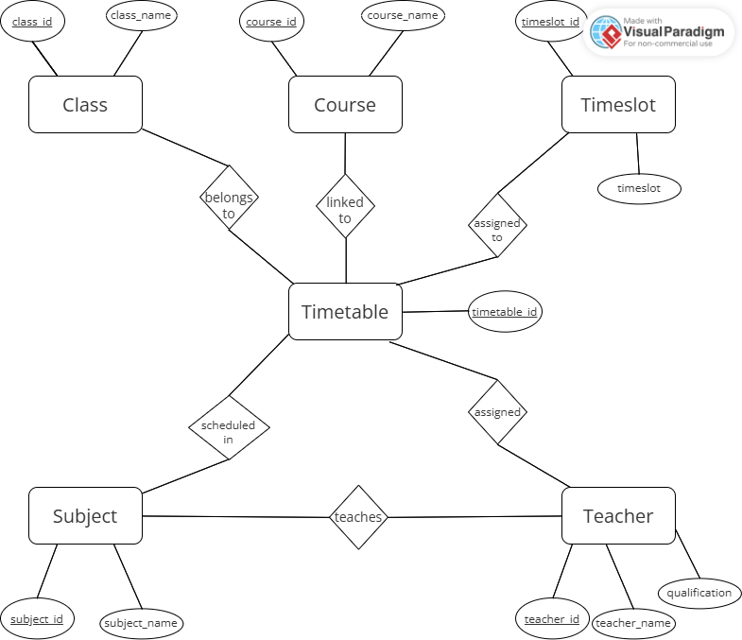
ER Diagram

Slide 11
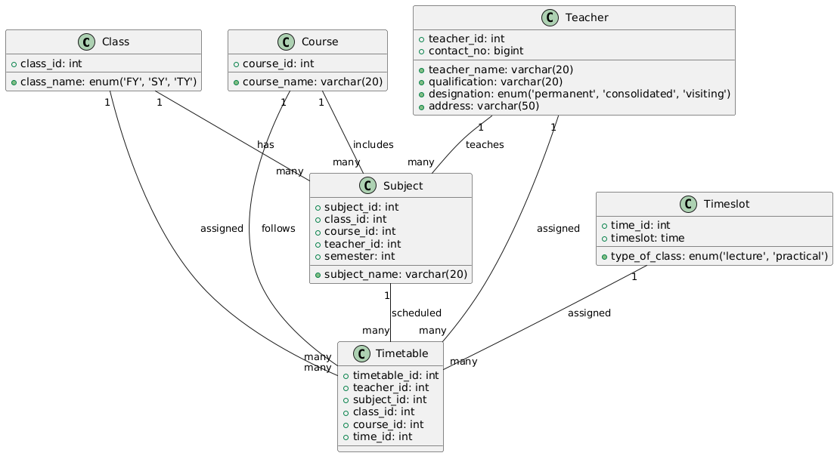
Class Diagram

Slide 12
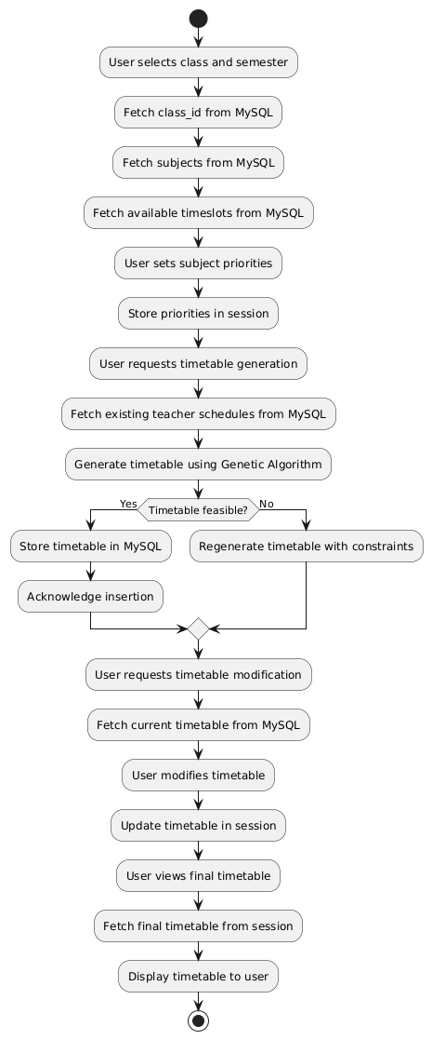
Activity Diagram

Slide 13
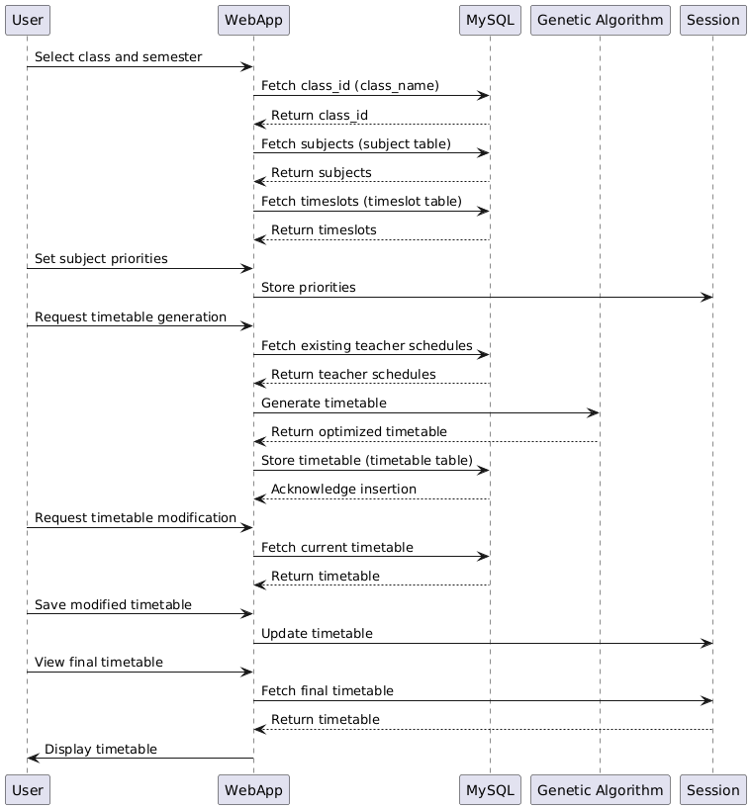
Sequence Diagram

Slide 14
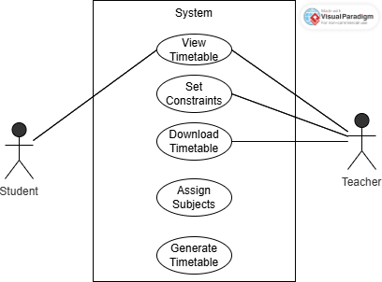
Use Case Diagram

Slide 15

Entering Constraints

Slide 16
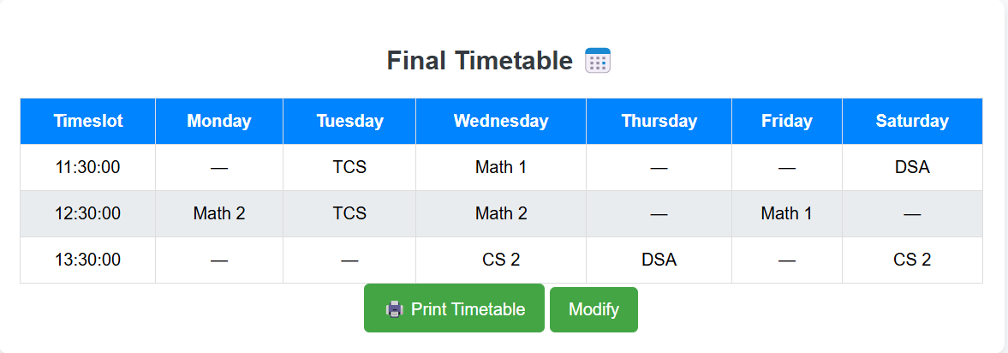
Timetable Generation

Slide 17
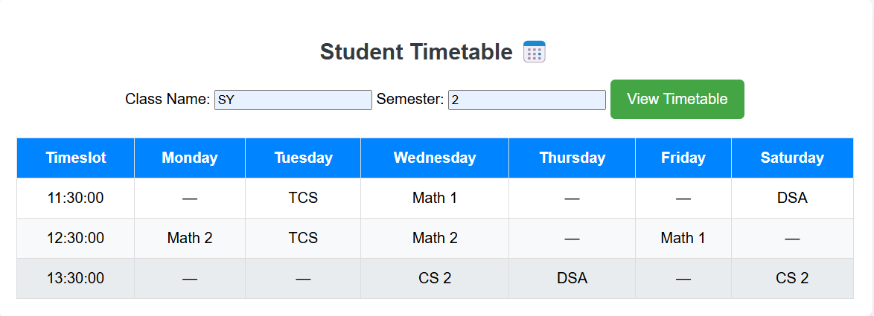
View Timetable

Slide 18
Future Enhancements
Mobile application integration
More intelligent conflict resolution
Multi-campus support
Advanced analytics for scheduling optimization

Slide 19

Conclusion
Successfully developed an AI-powered web application for timetable generation.
Reduced manual effort and errors in scheduling.
Applied Genetic Algorithm to optimize timetables efficiently.
Gained hands-on experience in Flask, MySQL, and AI-based scheduling.

